Slide 1
File Handling in Python
DVT101 – Lecture 45
- By Dataverse Tutorials

Slide 2
Introduction to File Handling in Python
What is File Handling
Why files are important in programming
Difference between memory data and file data
Real-life analogy of files vs RAM

Slide 3
Why Do We Need File Handling
Permanent data storage concept
Data reuse after program termination
Handling large data efficiently
Automation and configuration management

Slide 4
Types of Files in Python
Text files concept
Binary files concept
Common file extensions used in Python
Difference between text and binary data

Slide 5
File System & Backend Overview
How operating systems manage files
File paths and directories
Relationship between Python and OS file system
Role of file descriptors internally

Slide 6
File Operations Lifecycle
File creation concept
File opening concept
File processing concept
File closing importance
Resource management overview

Slide 7

Opening a File in Python
Purpose of opening a file
File path significance
File modes concept
Default behavior of file opening

Slide 8
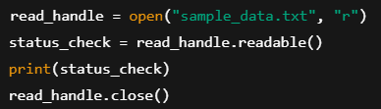
File Modes Explained
Read mode concept
Write mode concept
Append mode concept
Difference between destructive and non-destructive modes

Slide 9
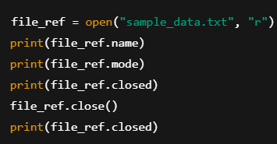
File Object & Its Properties
What is a file object
Metadata associated with a file
Tracking file state
Importance of checking file status

Slide 10
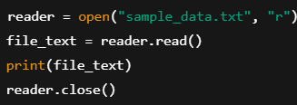
Reading Data from Files
Concept of reading file content
Memory implications of reading files
Sequential data access idea
When reading is commonly used

Slide 11
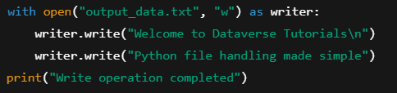
Writing Data to Files
Concept of writing data to storage
Overwriting vs updating data
File creation logic
Data persistence flow

Slide 12
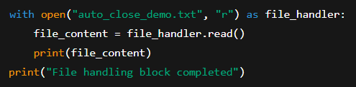
Using the with Statement
Automatic resource management
Why manual closing can fail
Cleaner and safer file handling approach
Industry best practices

Slide 13
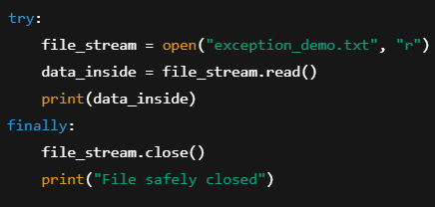
Exception Handling in File Operations
What can go wrong during file handling
Importance of error-safe programming
Ensuring file closure
Program stability benefits

Slide 14
Data Flow During File Handling
Program to file communication
Buffering concept
Read/write pipeline overview
Execution sequence internally

Slide 15
Real-World Industry Use Cases
Logging systems
Configuration files
Data preprocessing pipelines
Report generation systems

Slide 16
Common Mistakes in File Handling
Forgetting to close files
Using wrong file modes
Overwriting critical data
Memory and performance issues

Slide 17
Performance & Best Practices
Efficient file access strategies
Avoiding unnecessary reads
Choosing correct file modes
Clean and maintainable file logic

Slide 18
Summary & Key Takeaways
What file handling enables
Core concepts recap
Why every Python developer must know this
Transition to hands-on coding mindset

Slide 19


